Slide 1
Task 2 Data Visualization & Storytelling Superstore Sales Analysis Data Analyst Internship Name: S.Anusuya

Slide 2
INTRODUCTION
Objective: To analyze Superstore sales data and create meaningful visualizations that tell a business story.
Tools Used: Tableau
Dataset: Sample Superstore Dataset (CSV)
Focus Areas:
Sales performance
Profitability
Seasonality
Category distribution
High/low performing segments

Slide 3
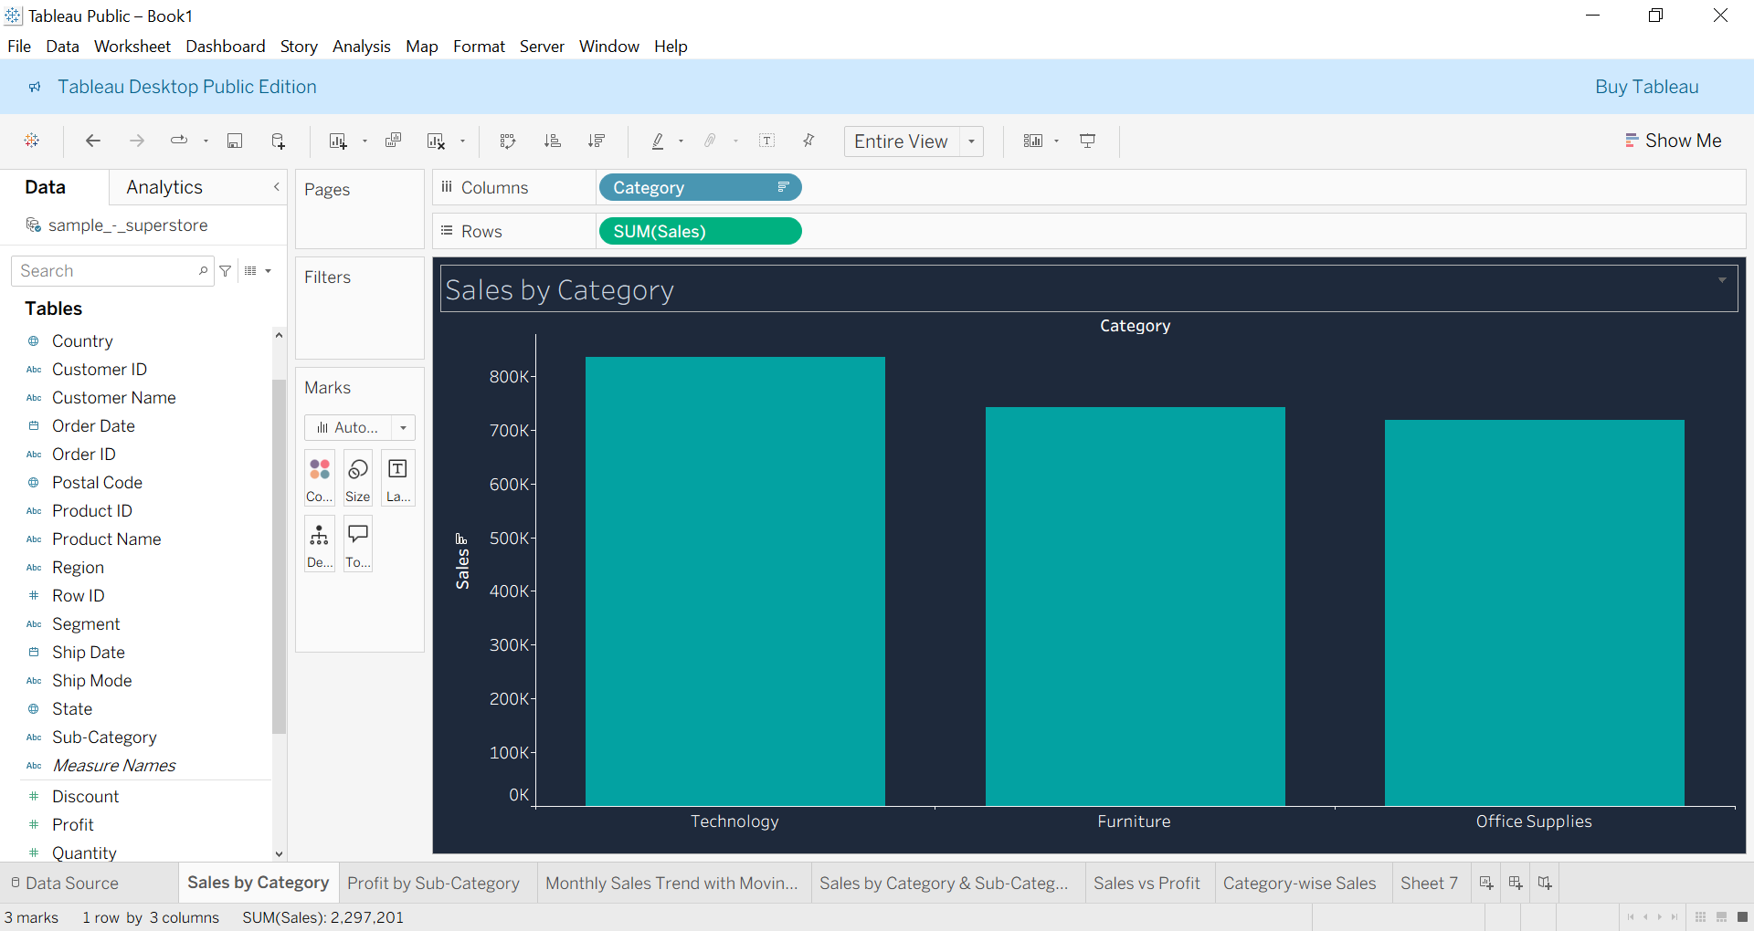
Sales by Category
Technology contributes the highest sales, followed by Furniture and Office Supplies. This shows Technology is the strongest revenue-generating category.

Slide 4
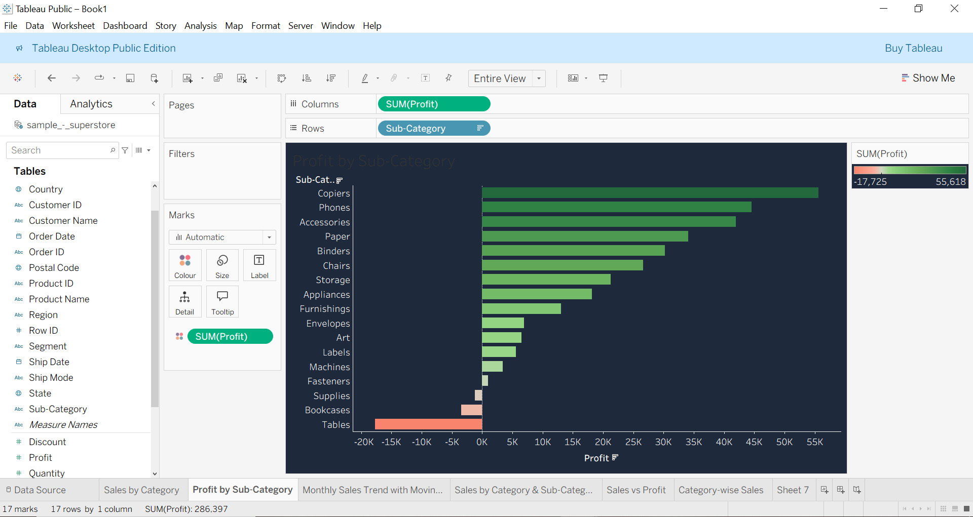
Profit by Sub-Category
Phones, Copiers, and Accessories generate strong profit levels. Tables and Bookcases show negative profit, indicating discount or cost-related issues.

Slide 5
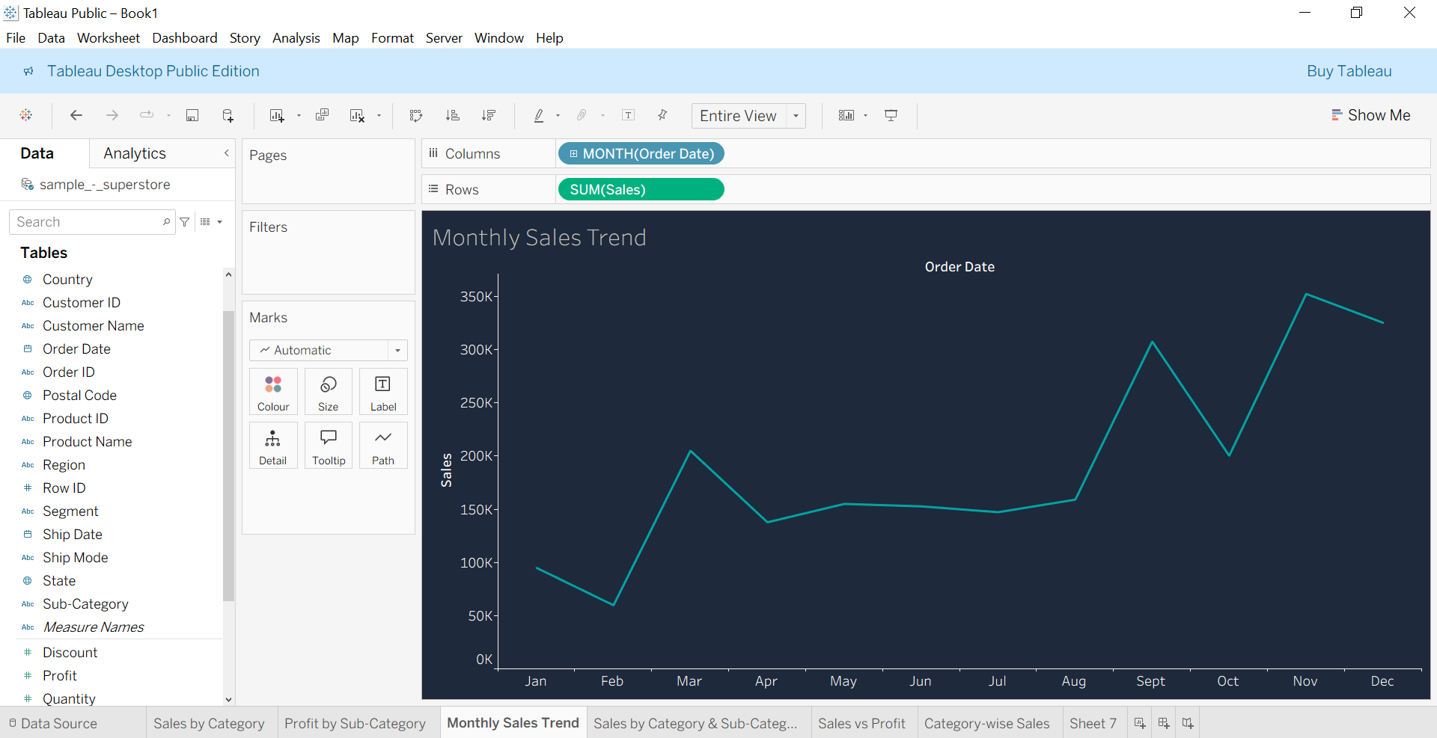
Monthly Sales Trend
Sales show clear seasonality, with major peaks in November and December due to holiday and festival purchases.

Slide 6
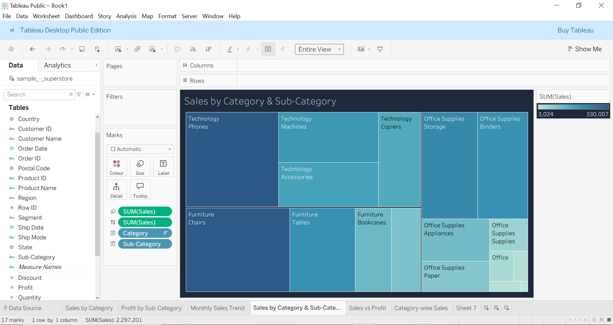
Category & Sub-Category Sales
Phones, Chairs, and Storage dominate sales within their respective categories. Some sub-categories require attention due to low contribution.

Slide 7
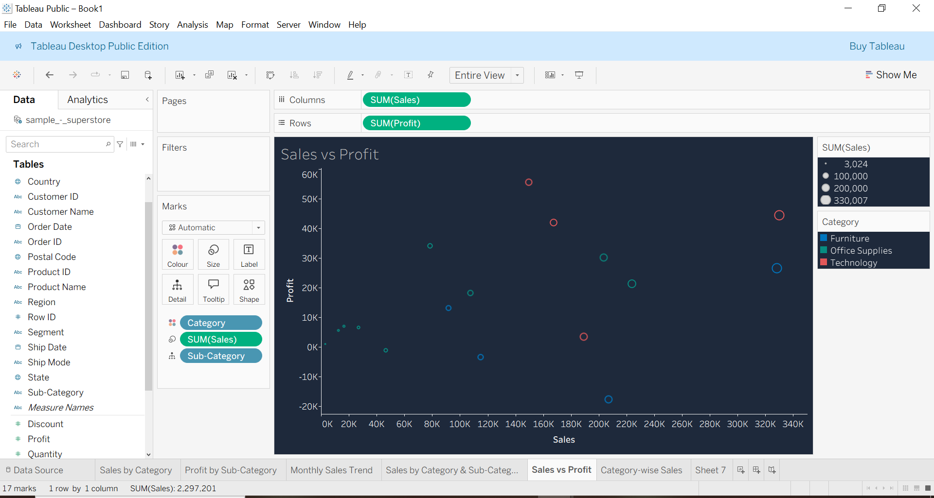
Sales vs Profit
Higher sales do not always mean higher profit. Some products with strong sales still show low or negative profit, pointing to pricing or discount problems.

Slide 8
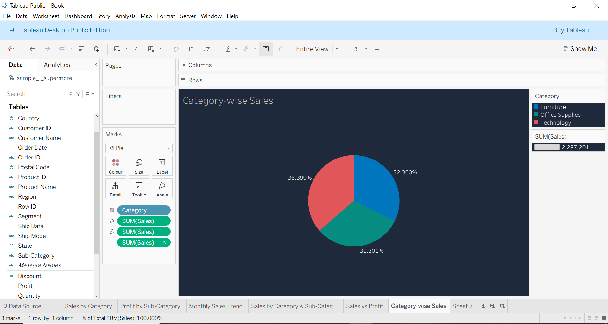
Category-Wise Sales Distribution
Technology holds the largest share of total sales, followed by Furniture and Office Supplies. This indicates priority areas for sales strategy and marketing focus.

Slide 9
CONCLUSION
This data visualization project provided insights into:
Sales performance across categories
Profitability patterns
Seasonal trends
Product-level sales variations
Discount impact on profit

Slide 10
Thank You Data Analyst Internship Task 2 Submission s. anusuya

